Slide 1
SOLVEDOKU

Slide 2
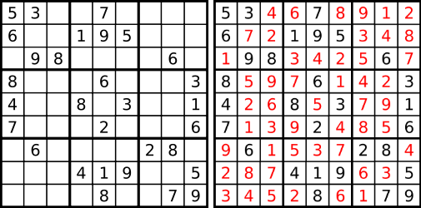
Introduction
SOLVEDOKU solves Sudoku puzzles using image recognition
SOLVEDOKU offers several benefits for the user
Allows for a quick solution to a newspaper Sudoku puzzle
Offers an easier solution finder than a text input Sudoku solver

Slide 3
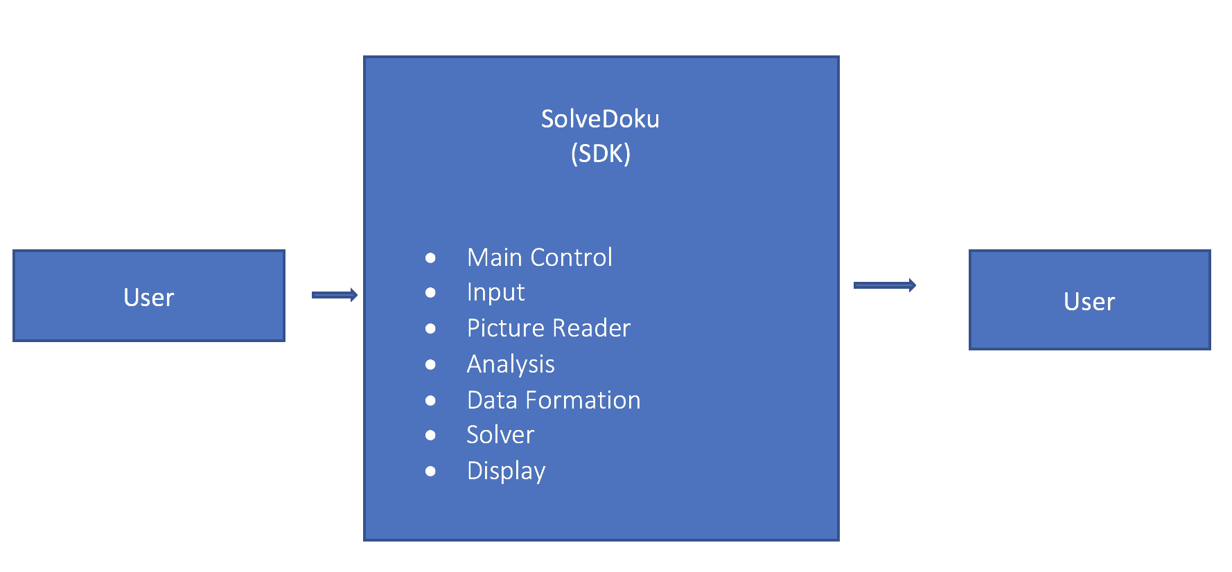
DFD LEVEL 0

Slide 4
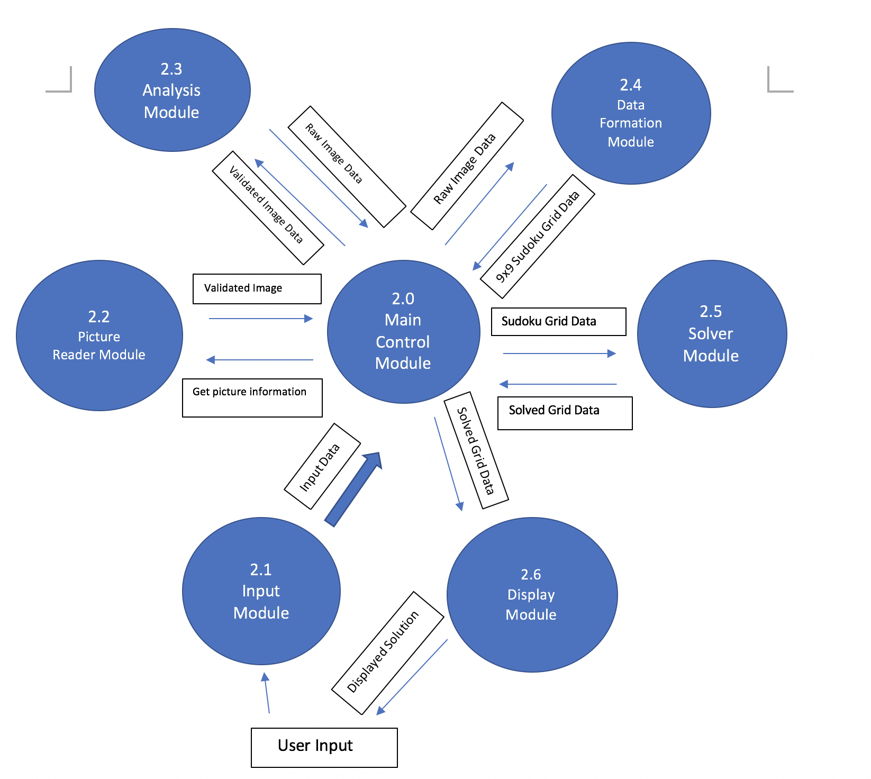
DFD LEVEL 1

Slide 5
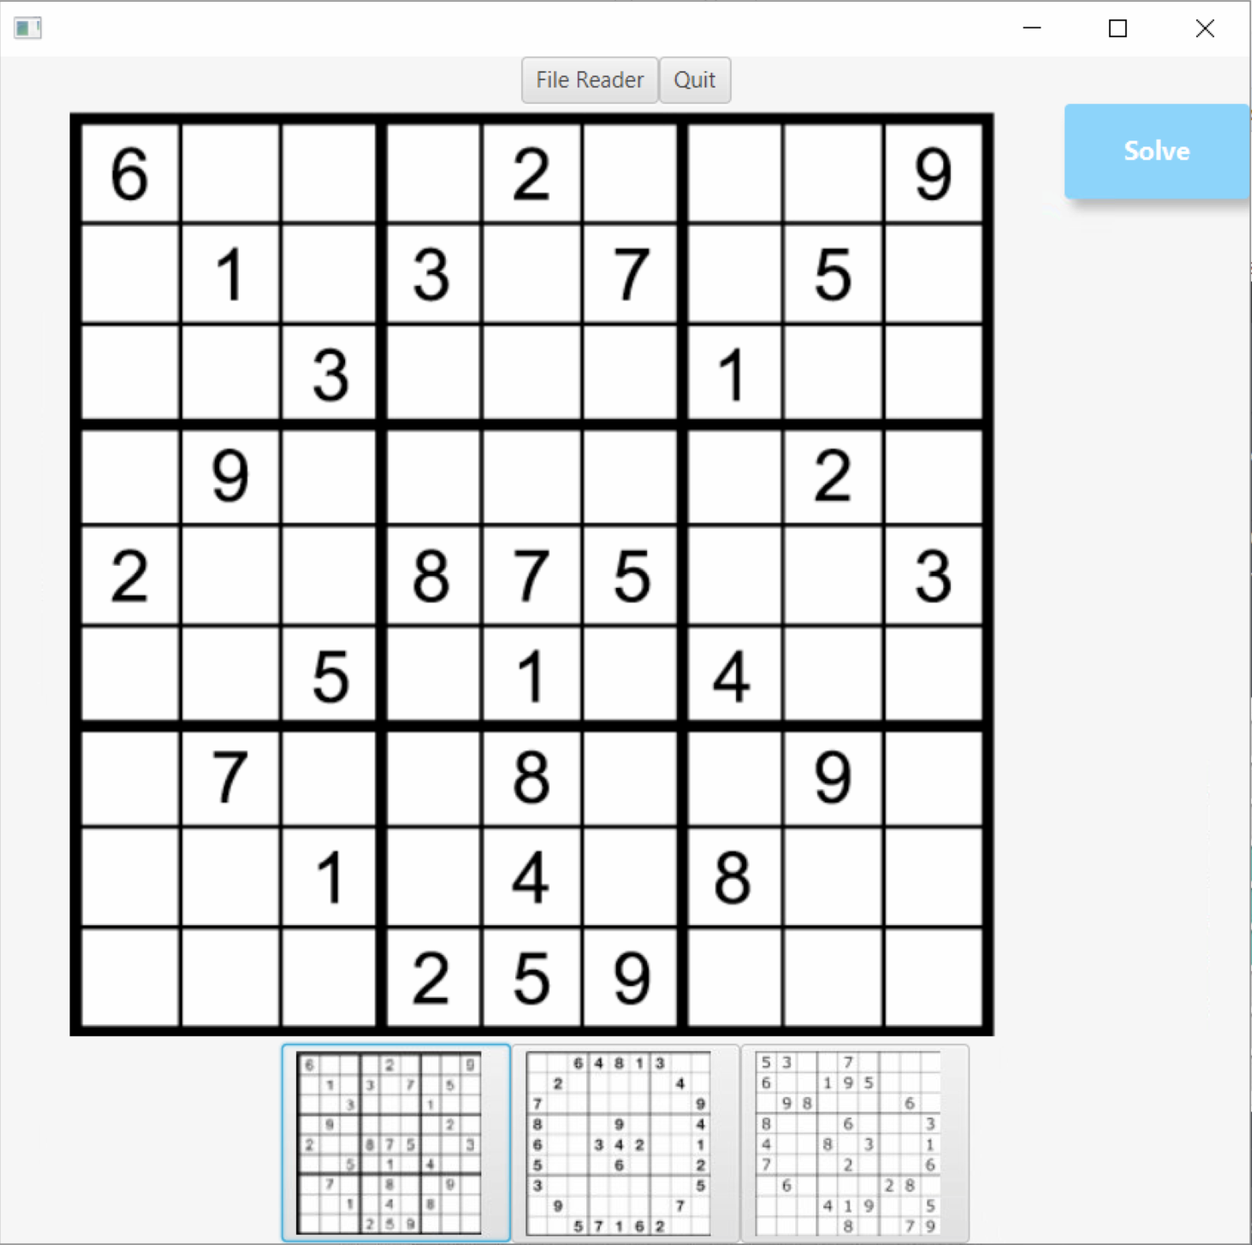
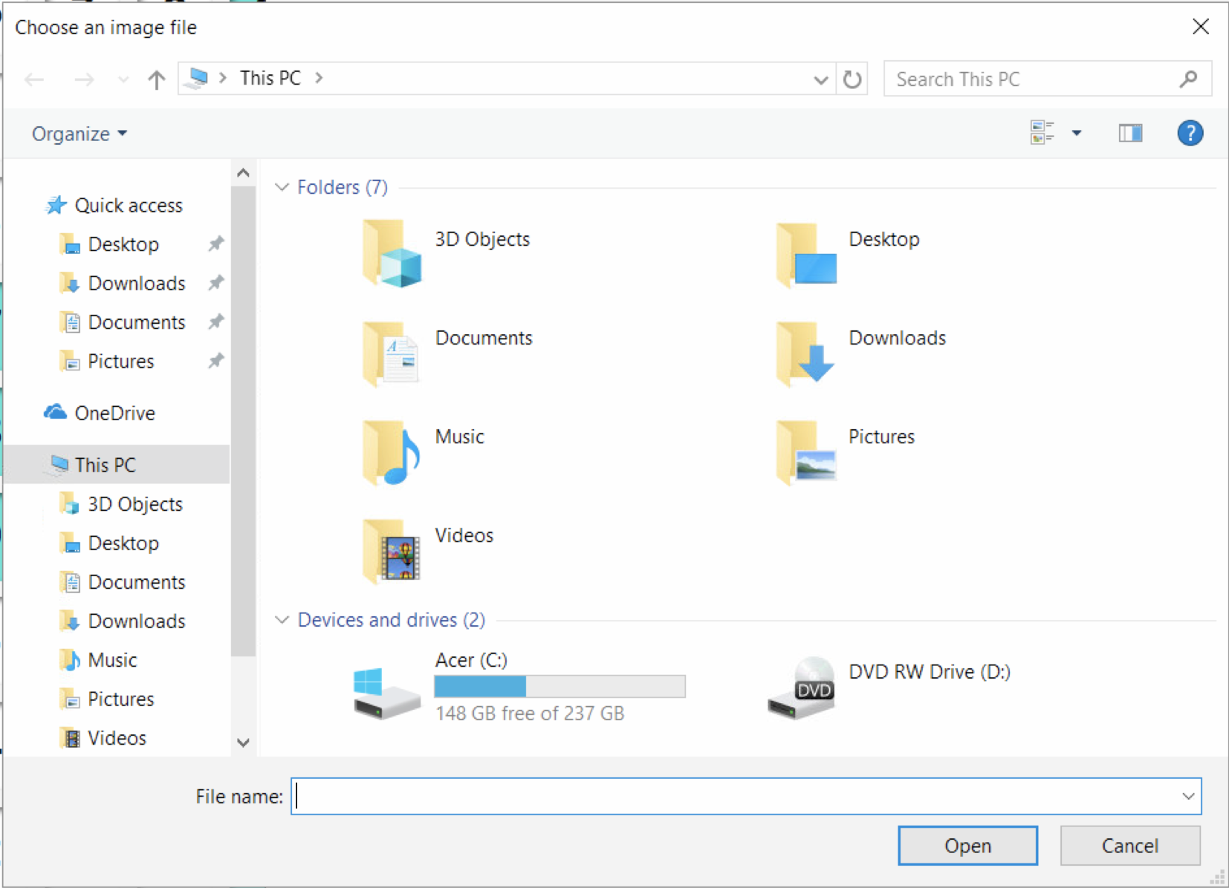
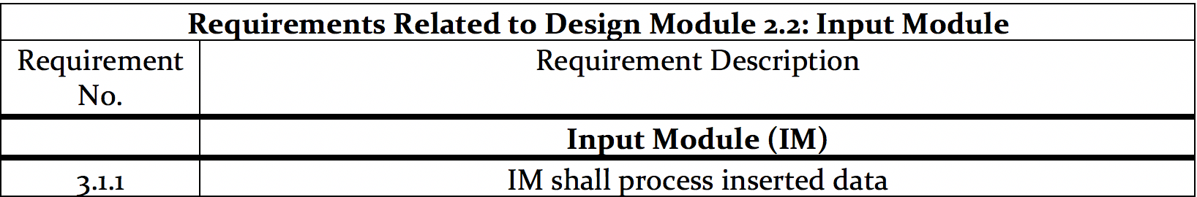
Input Module

Slide 6
DFD LEVEL 1

Slide 7
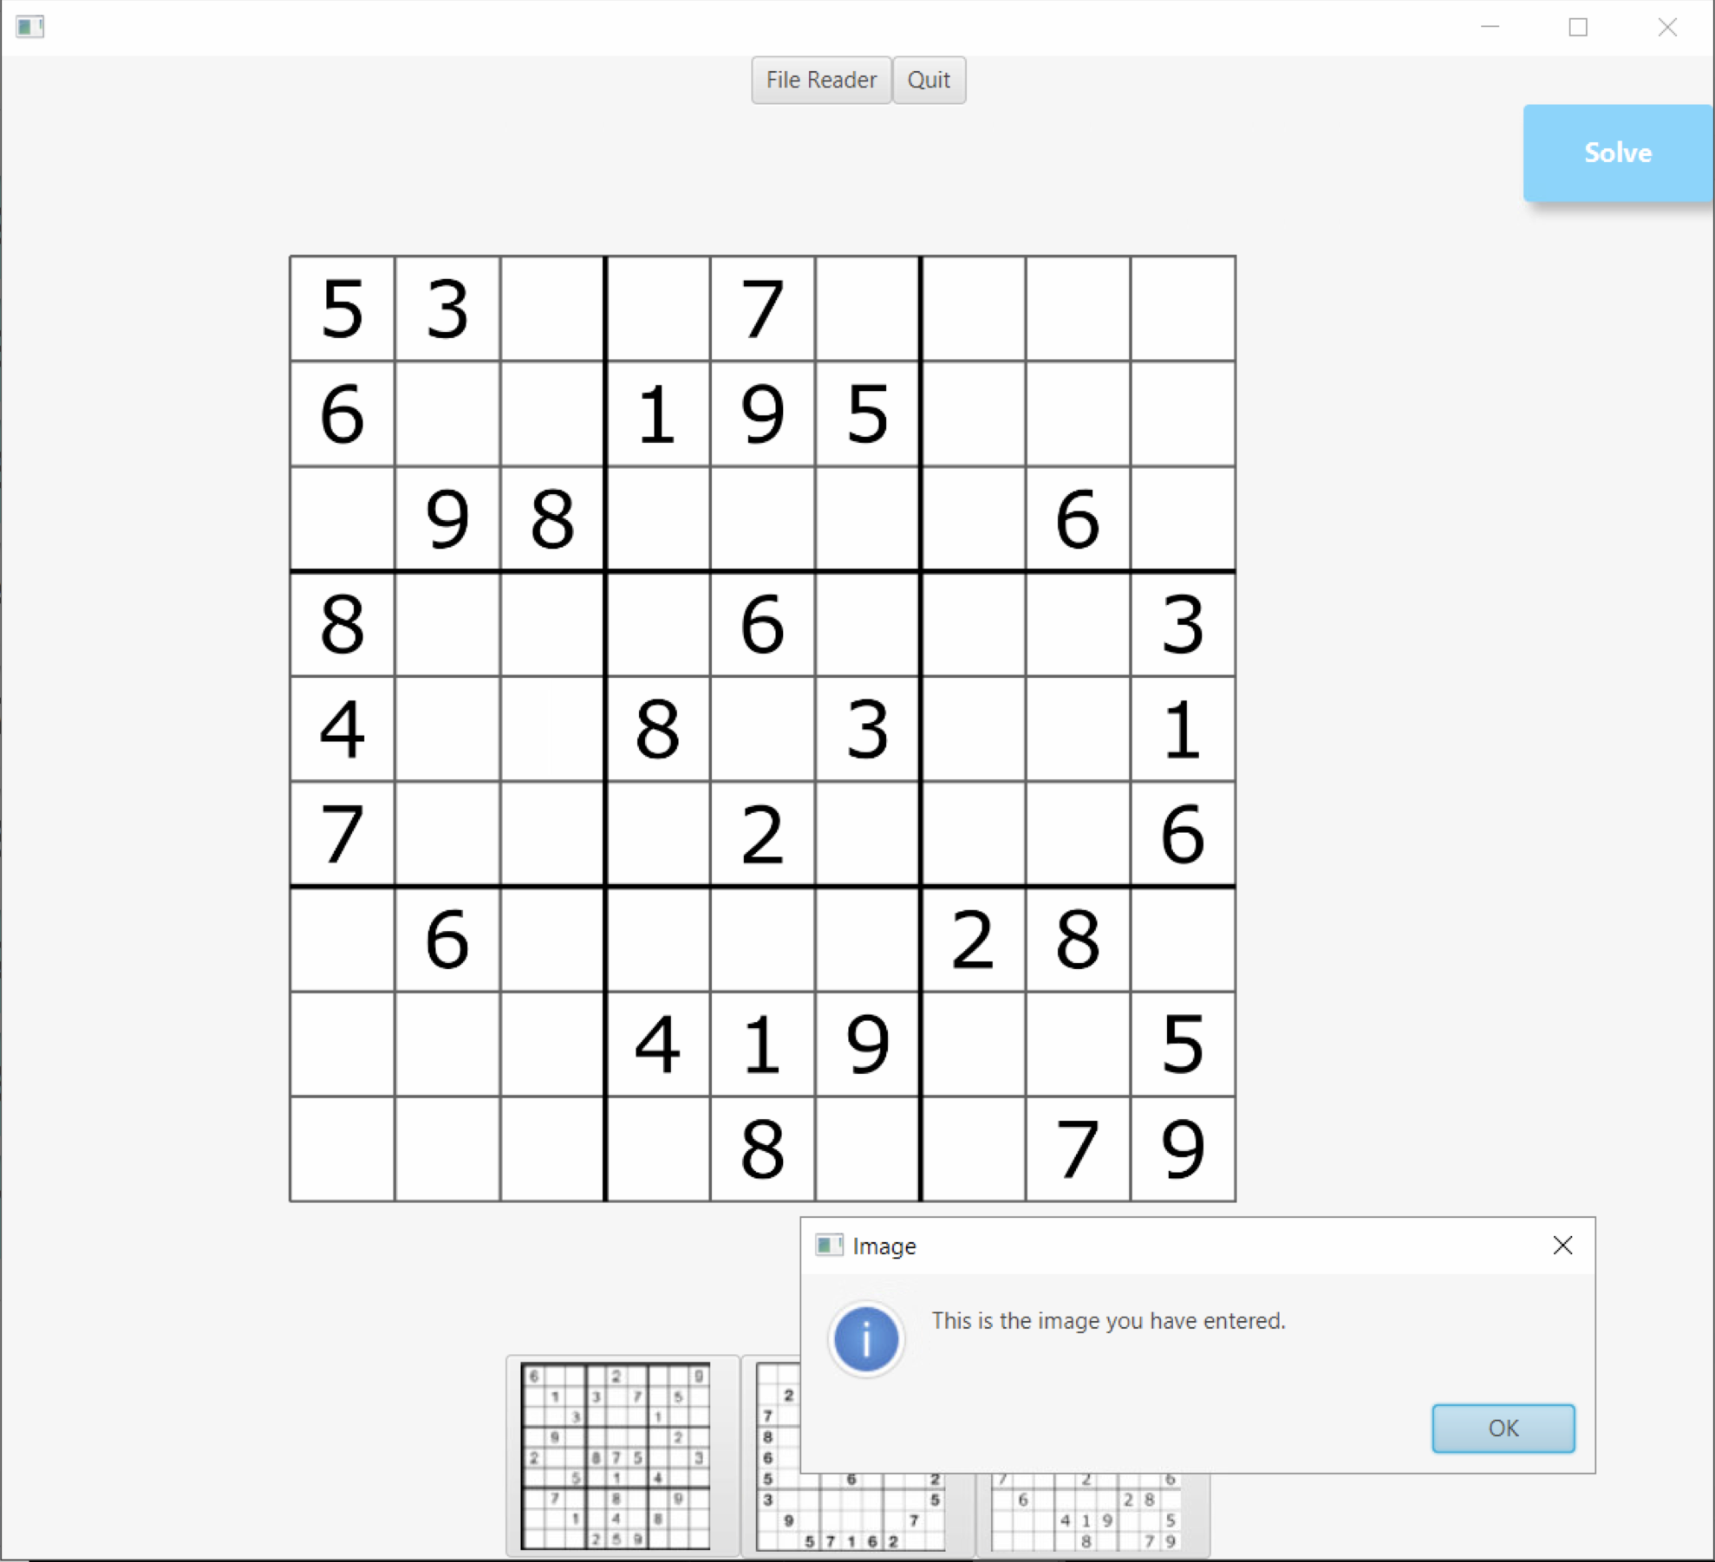
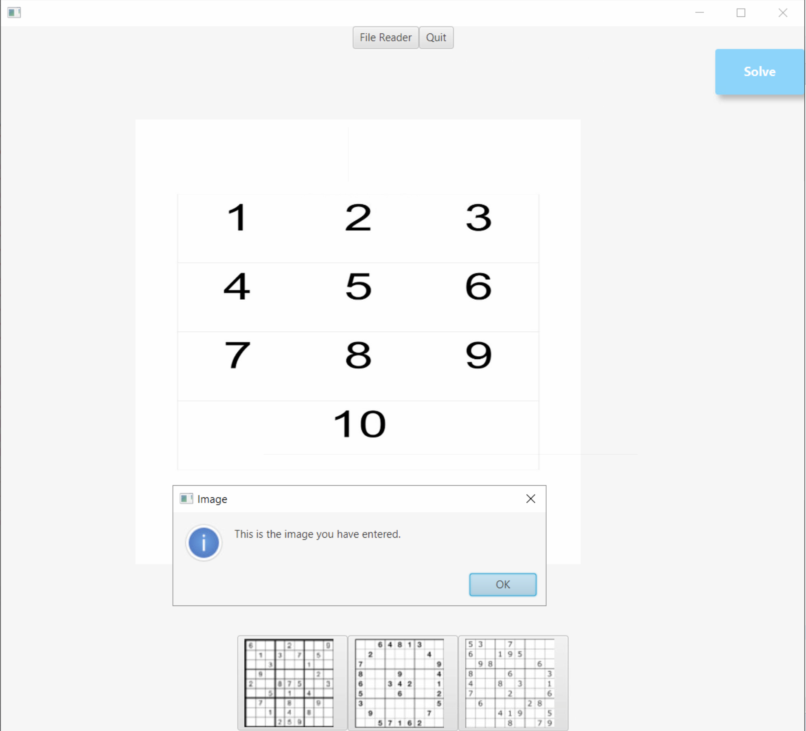
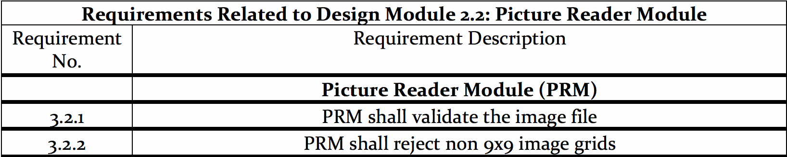
Picture Reader Module

Slide 8
DFD LEVEL 1

